Slide 1

Semester: Summer 2024-2025,Section: C
VLSI Final Project Presentation
Project Title: Design and Layout of the Logic Function ((A.B)+E+(C.D))’ Using Complementary CMOS Logic in Cadence Virtuoso.
Submitted to-
DR. SHAHRIYAR MASUD RIZVI
ASSOCIATE PROFESSOR, Dept. of EEE
Faculty of Engineering, AIUB
Submitted by-
Group Submission
Group Number: 01
Group Members-
American International University – Bangladesh
Department of Electrical and Electronic Engineering
EEE4217: VLSI CIRCUIT DESIGN LAB
SL | NAME | ID
1 | ABDULLAH AL MUJAHID | 22-49448-3
2 | NOASHIN ANJUM ANIKA | 22-48451-3
3 | SUBITA BINTA HASIB ANONNA | 22-48553-3
4 | RAKIB HOSSAIN | 22-48744-3

Slide 2

Outline of the Presentation
Aims and Objectives
Introduction
Theory and Logic Design
Truth Table
Methodology
Transient Measurement
Stick Diagram
Layout Design
Design Rule Check (DRC)
Layout vs. Schematic (LVS)
Conclusion

Slide 3
Aims and Objectives
1. Design the CMOS logic function F = ((A·B) + E + (C·D))’ with minimal transistors.
2. Simulate and verify the function in Cadence Virtuoso.
3. Optimize transistor sizes using a reference inverter.
4. Create a stick diagram with Euler’s path for layout efficiency.
5. Complete the physical layout and verify with DRC and LVS checks.
6. Analyze propagation delay post-layout.

Slide 4
Introduction
1. CMOS logic is widely used for its low power and reliable switching using complementary NMOS and PMOS transistors.
2. The project focuses on designing and verifying the logic function F = ((A·B) + E + (C·D))’ ,a NOR of two AND terms and one input.
3. Implementation involves building NMOS pull-down and PMOS pull-up transistor networks .
4. Key steps include schematic capture, stick diagram with Euler’s path, and layout design in 45nm technology.
5. Verification through simulations, DRC, LVS, and post-layout analysis ensures accuracy and performance.

Slide 5
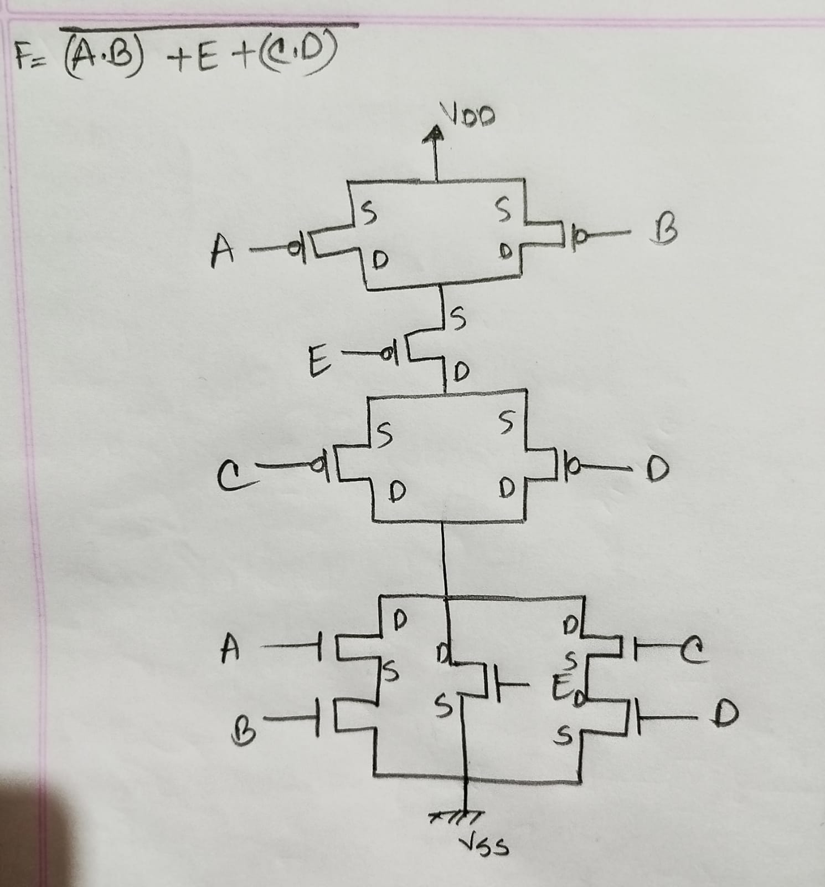
Theory and Logic Design
The Pull-Up Network (PUN) uses PMOS transistors arranged to implement the dual of the logic function.
The Pull-Down Network (PDN) uses NMOS transistors arranged to directly implement the original Boolean expression.
The function F = ((A·B) + E + (C·D))’ involves AND, OR, and NOT operations.
NMOS transistors in series and parallel form the PDN for the AND and OR terms.
PMOS transistors in complementary configurations form the PUN.
This CMOS design ensures proper logic operation by complementary switching between PUN and PDN.
Figure 1: Logic Gate-Level Representation of the Function F = ((A·B) + E + (C·D))’

Slide 6
Truth Table of F = ((A·B) + E + (C·D))’for Logic Function Verification
A | B | E | C | D | A.B | C.D | A.B+E+C.D | (A.B+E+C.D)’
0 | 0 | 0 | 0 | 0 | 0 | 0 | 0 | 1
0 | 0 | 1 | 0 | 1 | 0 | 0 | 1 | 0
0 | 1 | 0 | 1 | 0 | 0 | 0 | 0 | 1
0 | 1 | 0 | 1 | 1 | 0 | 1 | 1 | 0
1 | 0 | 0 | 0 | 0 | 0 | 0 | 0 | 1
1 | 0 | 1 | 0 | 1 | 0 | 0 | 1 | 0
1 | 1 | 0 | 1 | 0 | 1 | 0 | 1 | 0

Slide 7
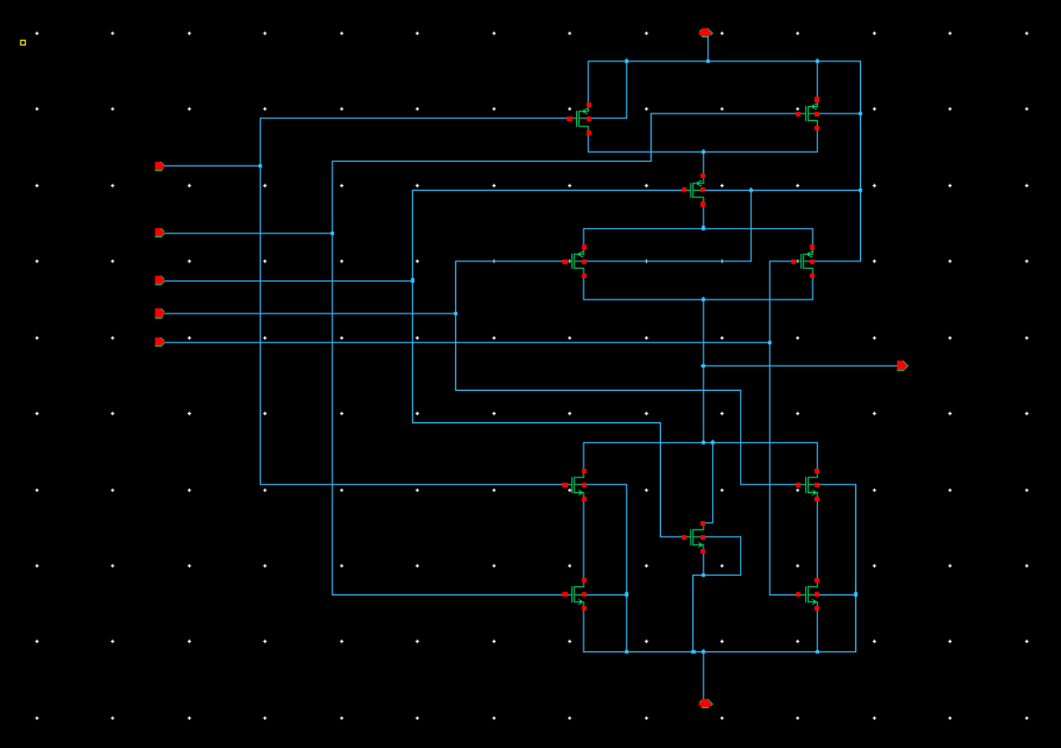
Methodology
Schematic Design in Virtuoso
•The circuit was created in the Virtuoso Schematic Editor XL using the gpdk045 technology library.
•The design included five PMOS and five NMOS transistors.
•Logic inputs A, B, C, D,E connected to the gates of the transistors.
•The final output node F came from the point where the pull-up and pull-down networks meet.
Figure 2: Transistor-Level CMOS Schematic of the Logic Function in Cadence Virtuoso For, F = ((A·B) + E + (C·D))’

Slide 8
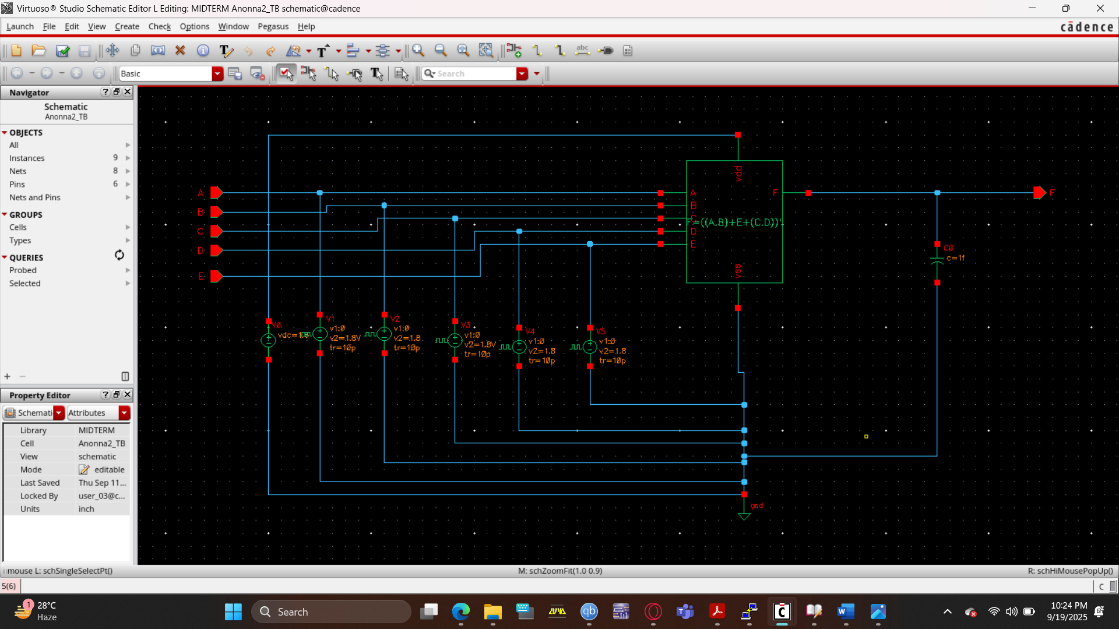
Setting Up Transient Simulation in ADE XL:
Once the schematic was finalized, we evaluated the dynamic response using the Analog Design Environment XL (ADE XL).
Power Supply Setup:
•A DC source of 1.8 V was connected to VDD.
•GND was set at 0 V.
Input Signal Configuration:
Inputs A, B, C, D, and E received the same pulse waveforms.
•Period: 10 ns
•Voltage levels: 0 V (low) to 1.8 V (high)
•Rise time: 10 ps
•Fall time: 10 ps

Slide 9
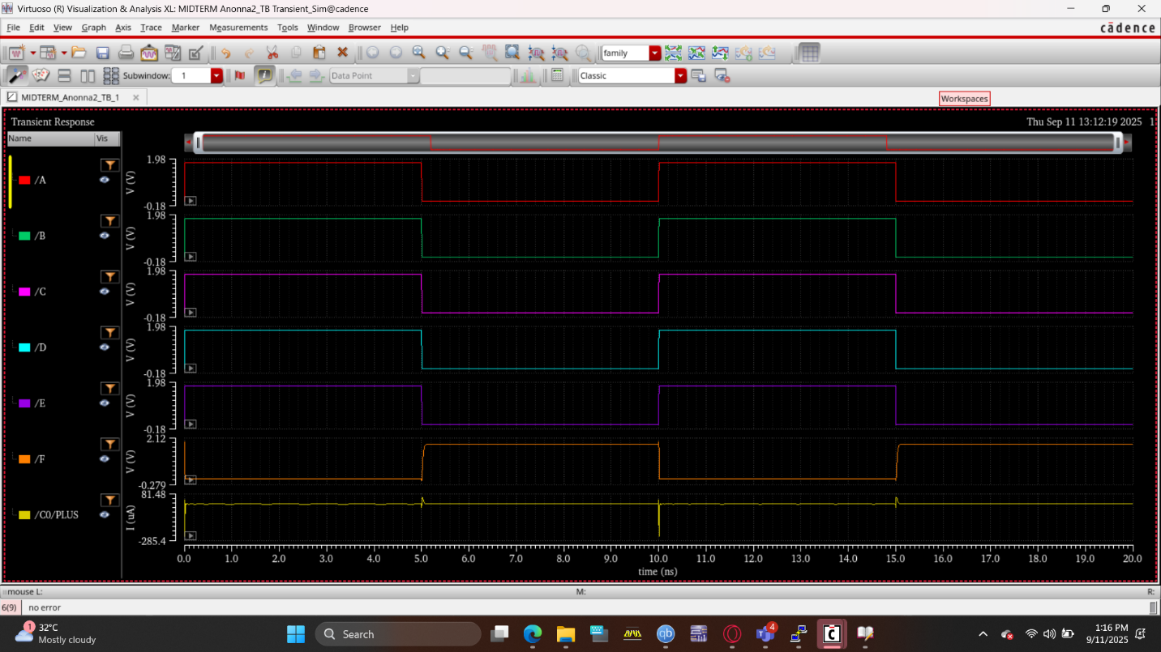
Transient Analysis Procedure:
•We selected the transient ("tran")analysis option from the Choose Analyses panel.
•Under Outputs → Setup, we marked nodes A, B, C, D, E, and F as probes.
•The simulation ran using Netlist and Run.
•We examined the resulting waveforms in the ADE waveform viewer and confirmed they matched the expected logic function.

Slide 10
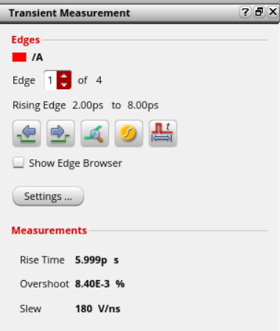
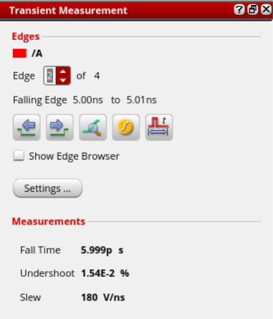
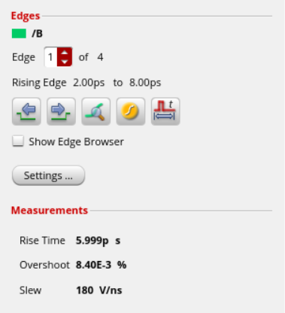
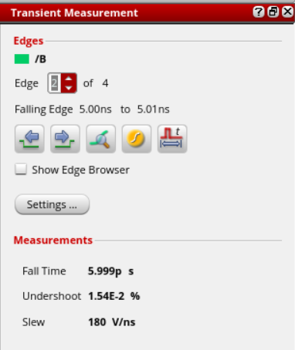
Transient Measurement
Pin ‘B’
Pin ‘A’

Slide 11
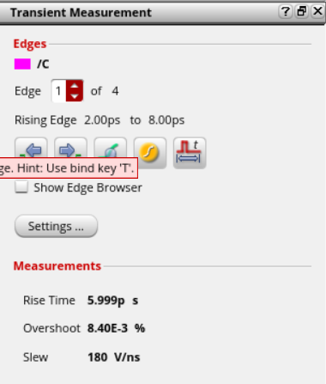
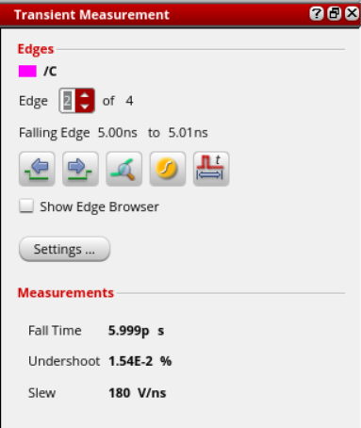
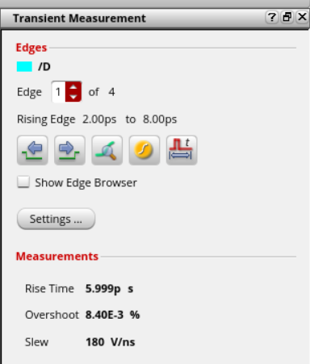
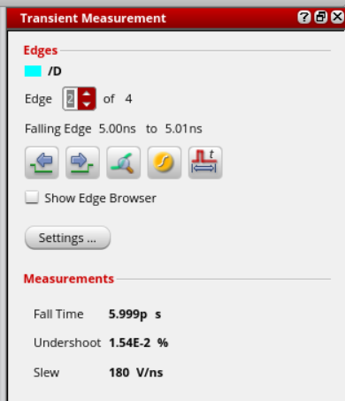
Transient Measurement
Pin ‘D’
Pin ‘C’

Slide 12
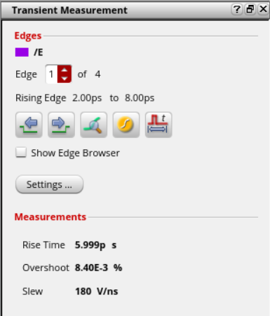
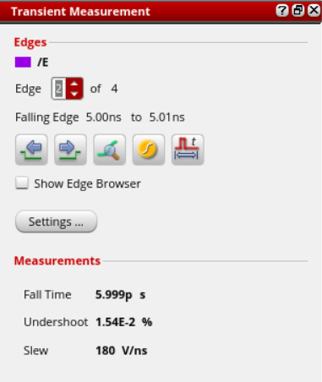
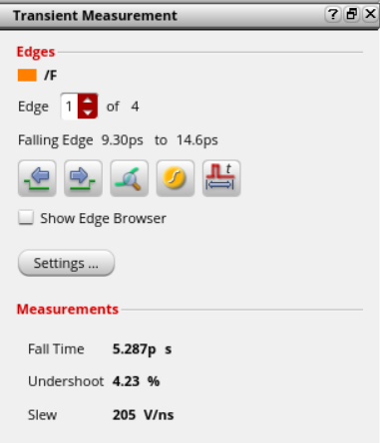
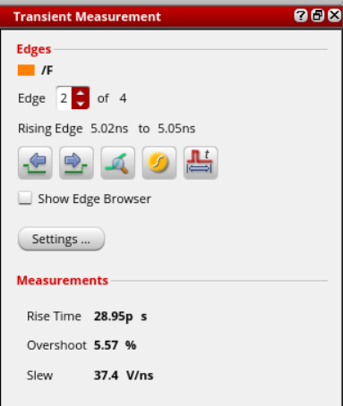
Transient Measurement
Pin ‘F’
Pin ‘E’

Slide 13
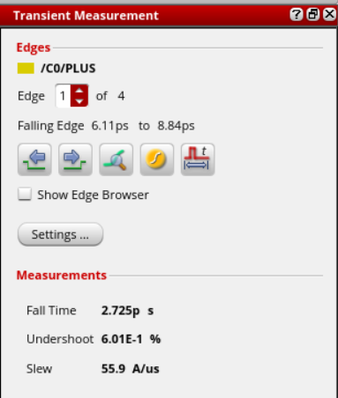
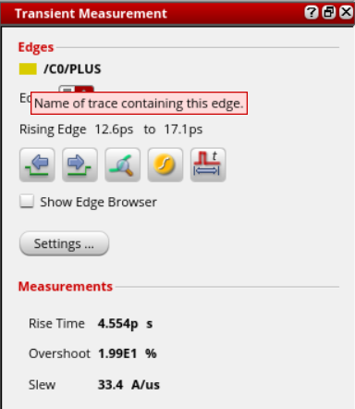
Transient Measurement of Logic Function:
Signal | Rise Time (tr) [ps] | Fall Time (tf) [ps]
A | 5.999 | 5.999
B | 5.999 | 5.999
C | 5.999 | 5.999
D | 5.999 | 5.999
E | 5.999 | 5.999
F | 5.287 | 28.95
CO/PULS | 2.725 | 4.554

Slide 14
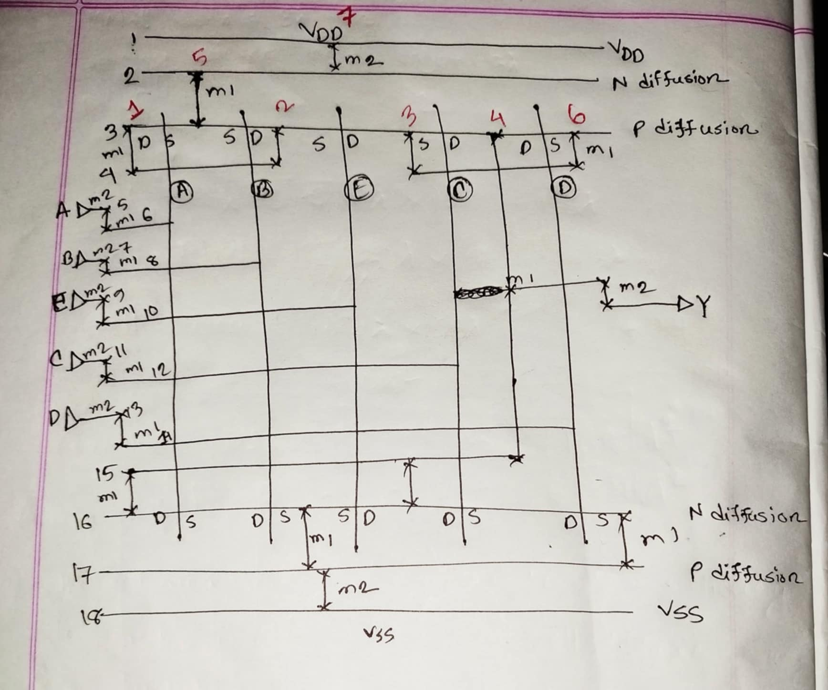

Stick Diagram:
A manual stick diagram was drawn using the Euler path A–B–E–C–D to optimize transistor placement.
Shared diffusion regions were utilized to minimize layout area.
Source and drain terminals were clearly marked.
Different layers such as polysilicon, n-diffusion, p-diffusion, Metal1, and Metal2 were represented.
Body contacts and VDD/GND rails were also included in the diagram.
Cell Area Estimation
No horizontal metal/ diffusion tracks = 18
No of vertical metal tracks = 7
Given that every diffusion or metal track must maintain a minimum width of 4λ, and a 4λ separation is required between neighboring metal layers,
Approximate cell area = [18 ×(4λ + 4λ )]×[7×(4λ + 4λ)]= 8064$λ^{2}$

Slide 15
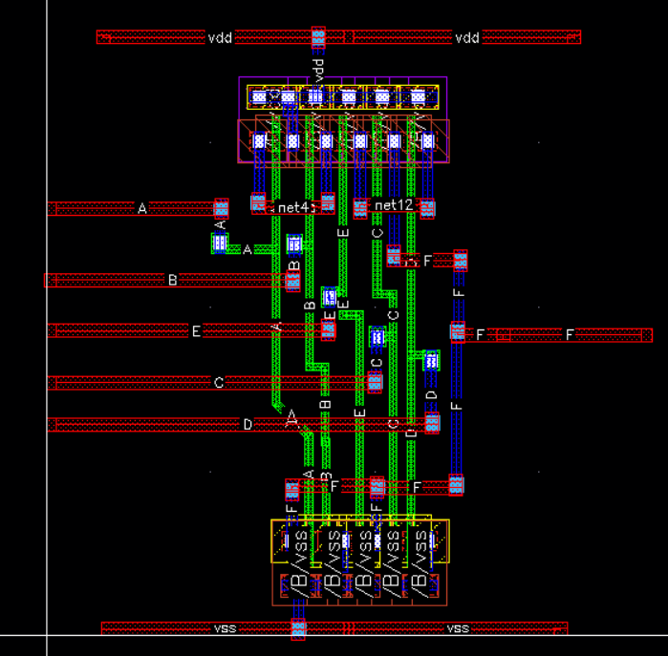
Layout Design
•The layout was initiated from the schematic using Launch → Layout XL.
•Devices were auto-placed via Generate → All from Source.
•Snap settings were configured to any-angle (option-display → Snap mode → create anyangle) and later set to diagonal with a stop time of 10.
•Metal1 and Metal2 were used to route VDD, GND, inputs, and outputs.
•Vias were inserted between metal layers wherever necessary.
•The layout was refined manually to ensure compactness, symmetry, and full DRC compliance.
•The Euler path strategy helped reduce diffusion breaks and routing congestion.

Slide 16
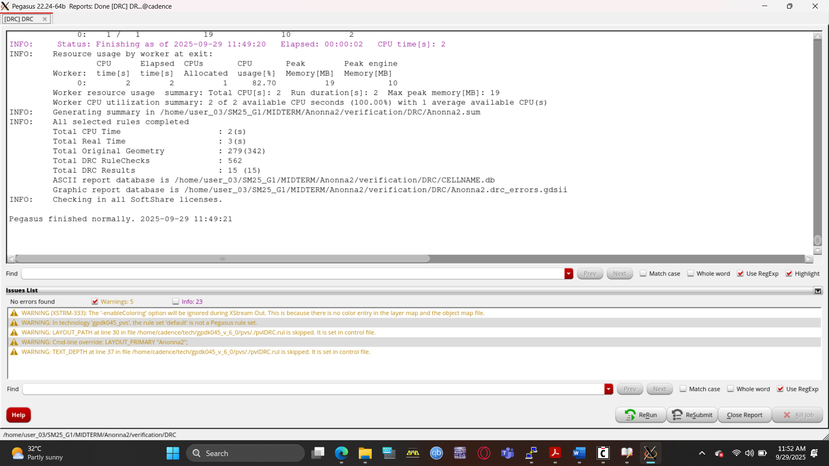
Design Rule Check (DRC)
Pegasus → Run DRC was executed using 45nm gpdk PDK rule definitions.
All spacing, width, enclosure, and contact constraints were validated.
The layout passed DRC successfully with zero violations.

Slide 17
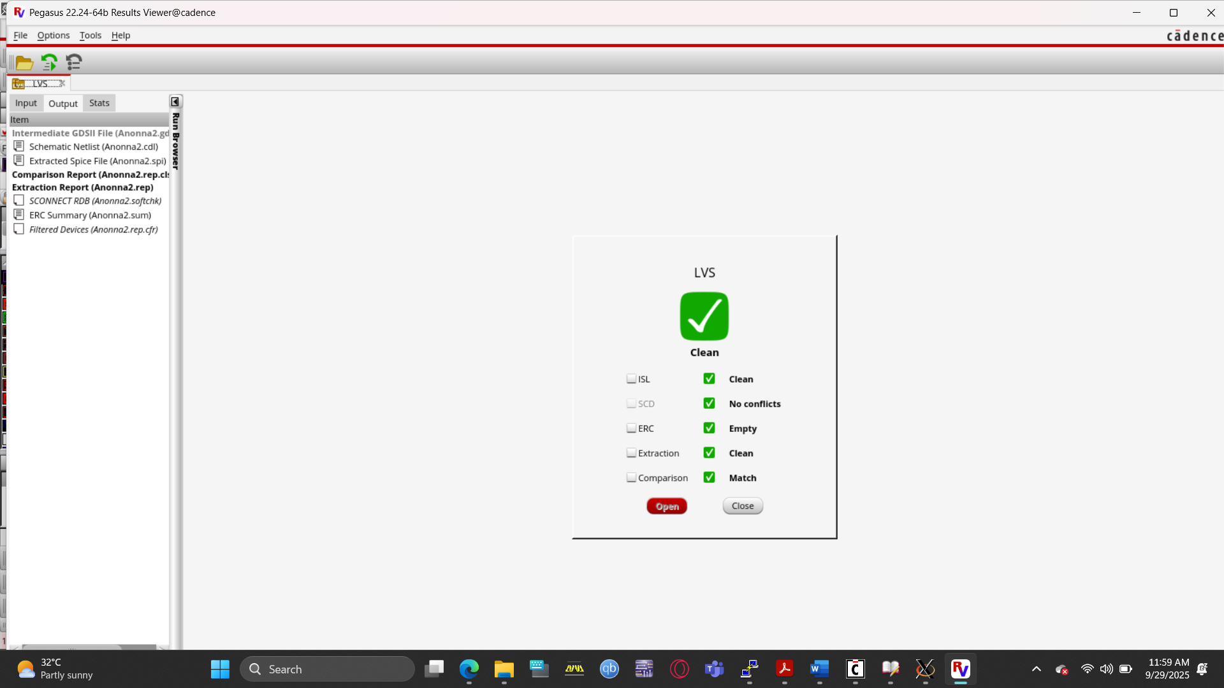
Layout vs. Schematic (LVS)
Pegasus → Run LVS was used to compare the extracted layout netlist with the original schematic.
Verification included:
  Device count consistency
  Correct pin-wise connectivity
  Proper instance recognition
LVS passed with a 100% match, confirming no errors or warnings.

Slide 18
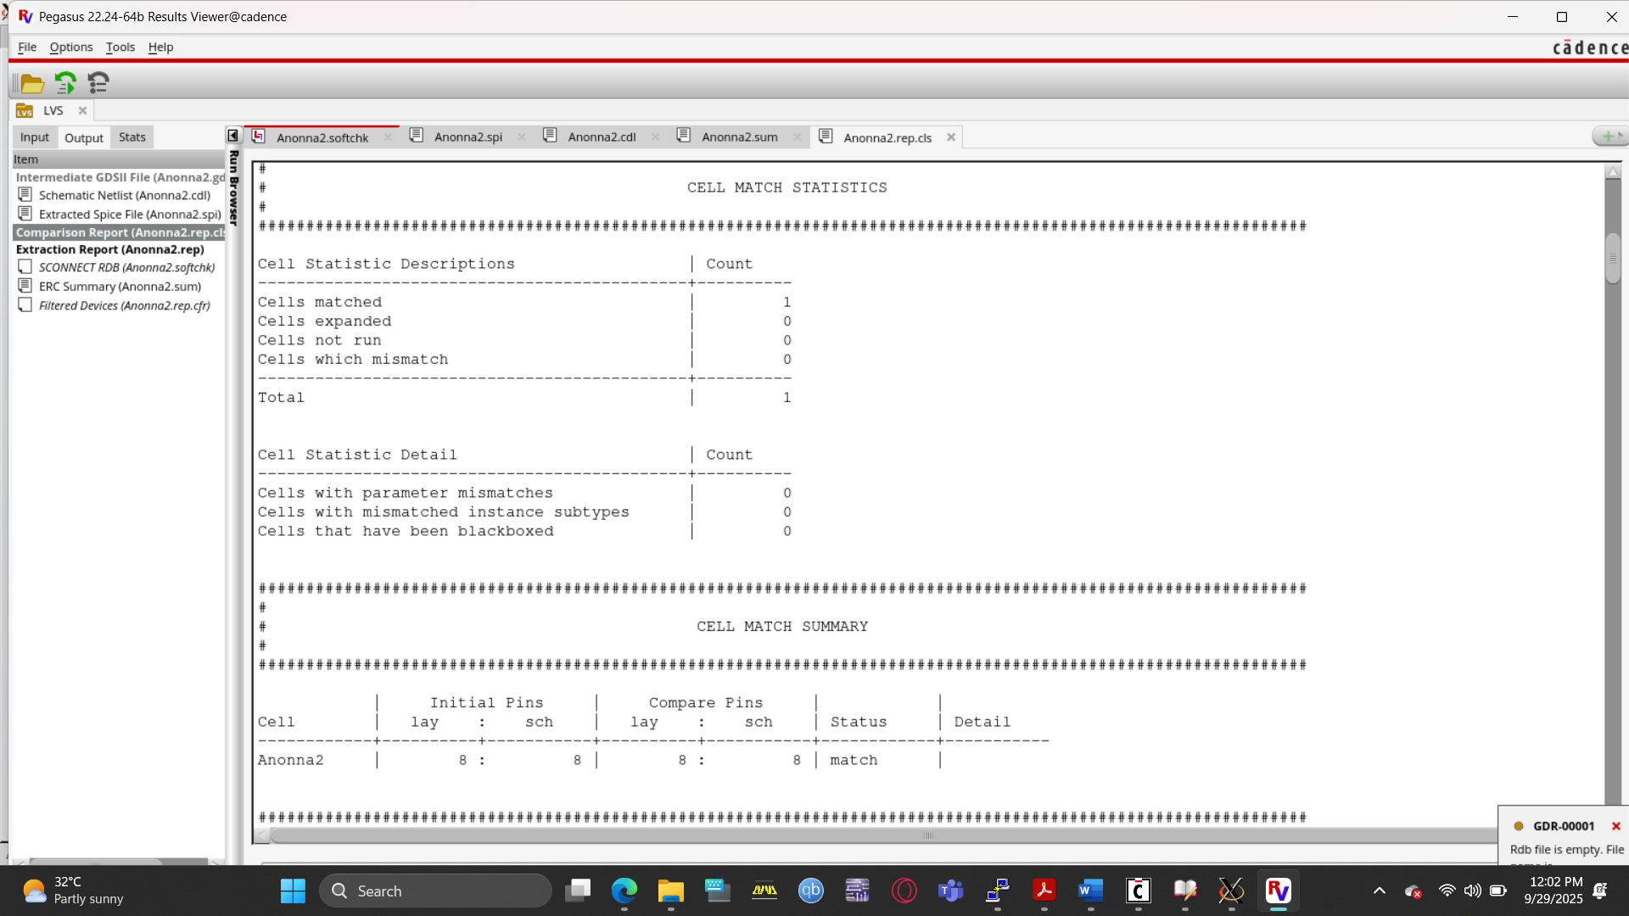
CELL MATCH STATISTICS AND CELL MATCH SUMMERY

Slide 19
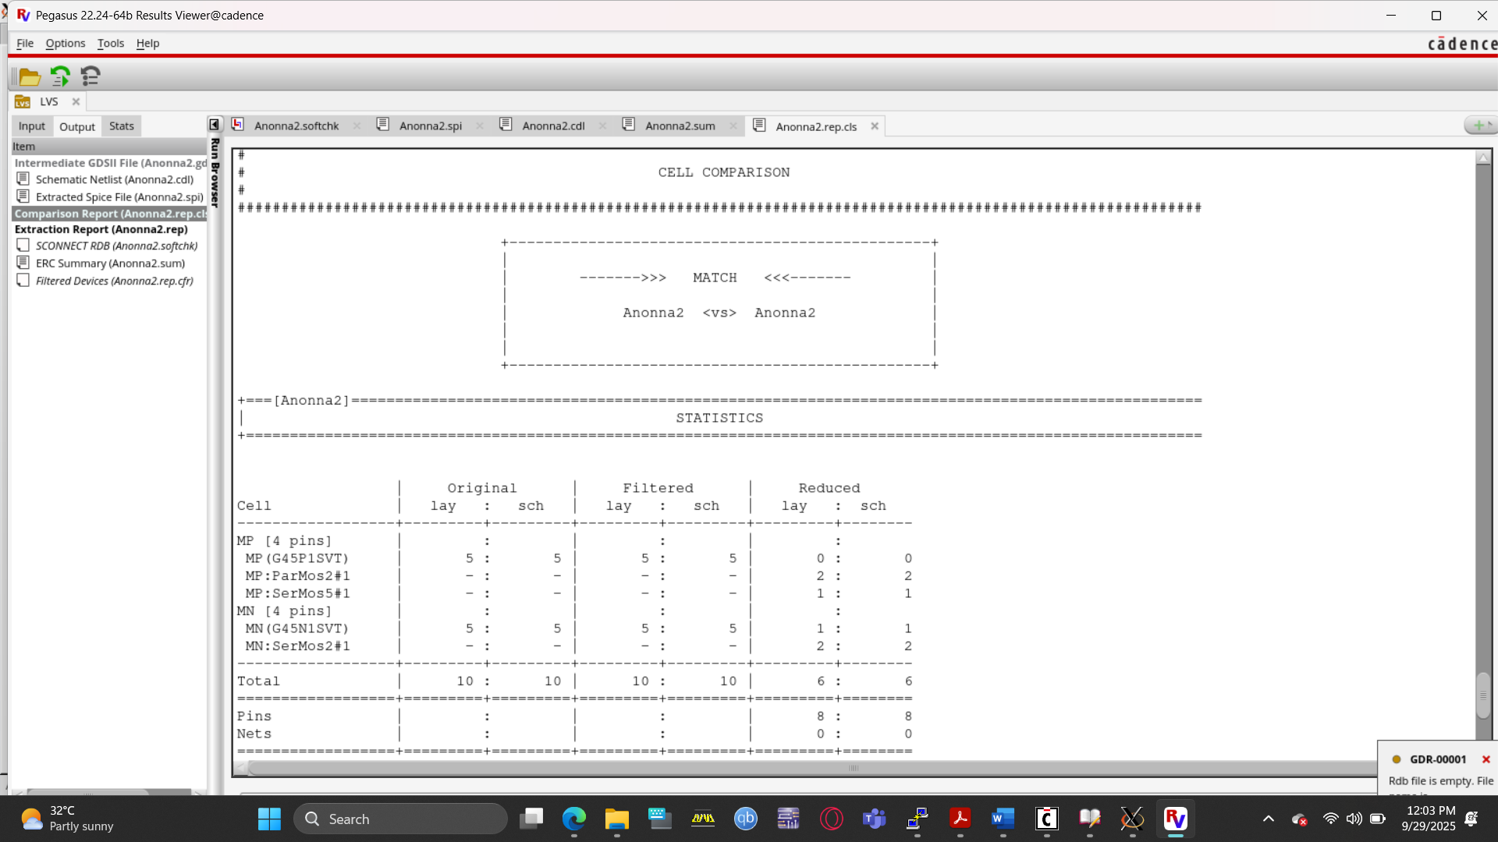
CELL COMPARISON

Slide 20
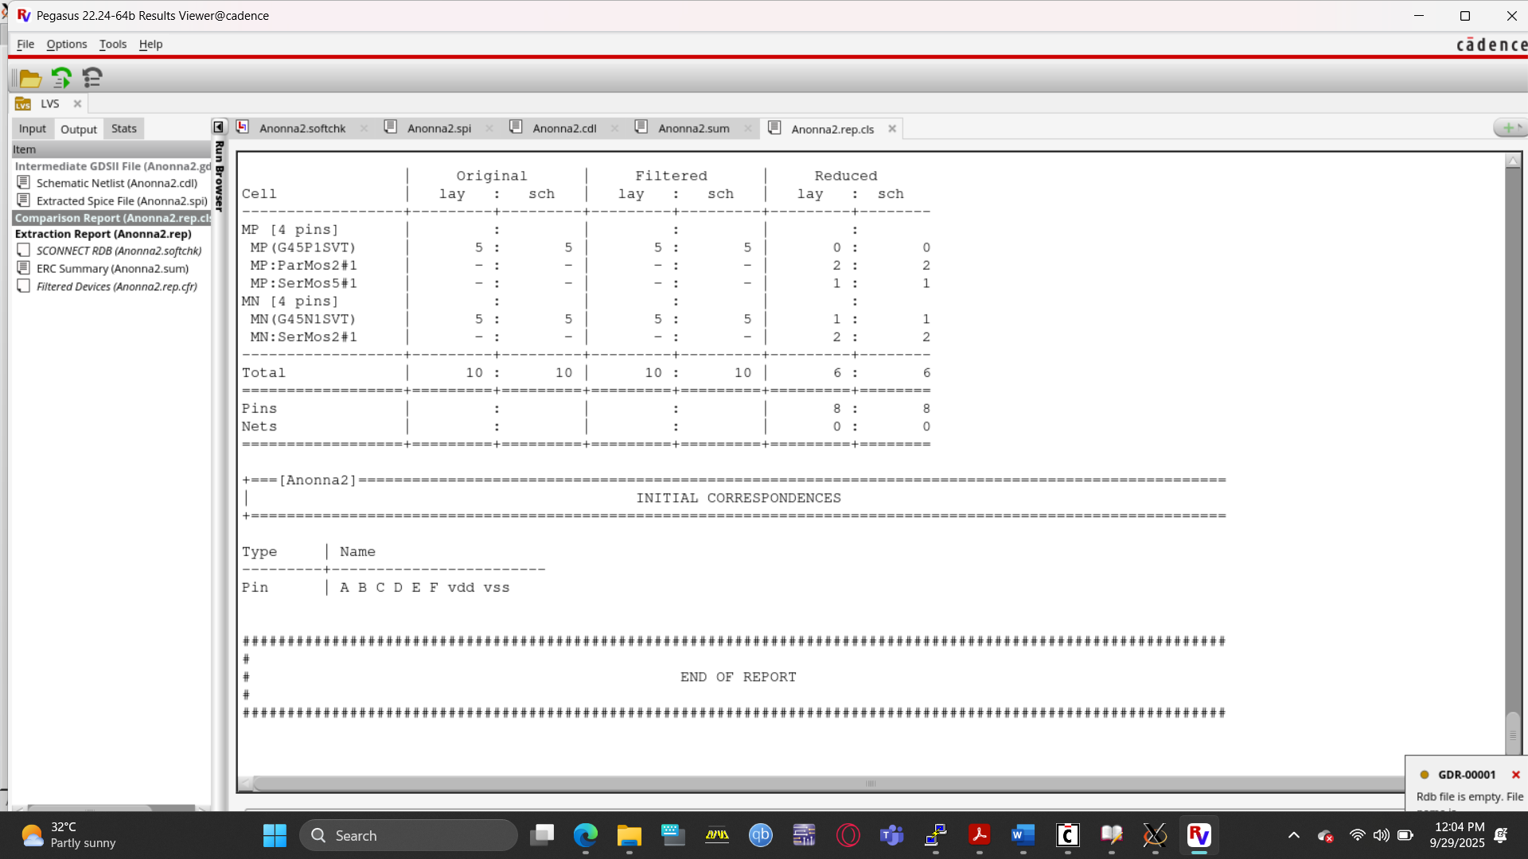
INITIAL CORRESPONDENCES

Slide 21
CONCLUSION
Designed and simulated the logic function F=((A.B)+E+(C.D))’ using complementary CMOS technology on Cadence Virtuoso with 45nm GPDK process.
Followed a structured design flow: transistor sizing, schematic capture, simulation, stick diagram creation, layout design, and final verification via DRC and LVS.
Used Euler path optimization in stick diagram development to achieve an efficient and manufacturable layout.
Transient simulations verified logical correctness, signal integrity, and timing accuracy before and after considering parasitic effects.
Clean DRC and LVS reports confirmed the layout’s compliance with electrical and fabrication rules, indicating readiness for manufacturing.
Extracted SPICE netlist showed robust circuit performance despite parasitic effects; gained hands-on experience in CMOS design, layout optimization, and verification essential for VLSI development.

Slide 22

Thanks for listening our presentation….

